Slide 1
Making an early start on the library journey –
Black & white bookmaking
Margaret Street
Early Years Librarian
margaret.street@hertfordshire.gov.uk

Slide 2
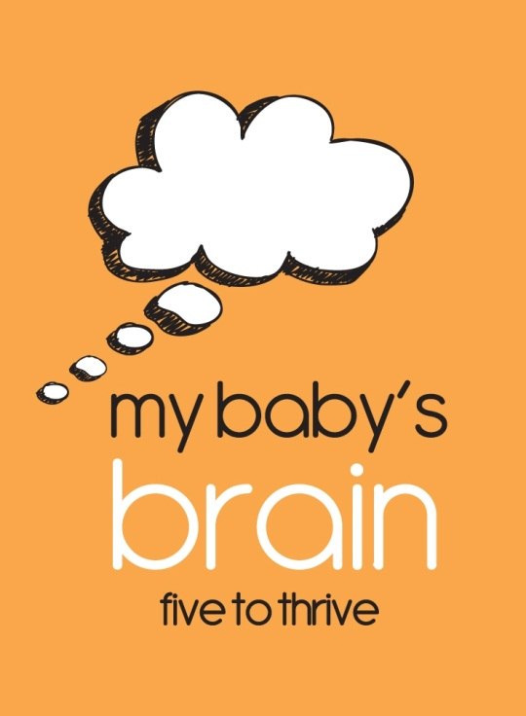
A County wide approach
Notes:
We all know that there is nothing more important in the lives of young children than their parents. Recent research proves that how a parent behaves around their baby in the first three years of life has a direct impact on how their baby's brain develops. This is the foundation of how the brain will work as the child grows up and becomes an adult, so if a baby's brain develops healthily they are more likely to be happy and successful as older children and adults.
Hertfordshire County Council , Childhood Support Services - working with Kate Cairns Associates came together to produce My Baby’s Brain – five to thrive key messages.
Multi partnership work and training. Used by Early Years settings, Health Visitors, Childminders and Children’s Centre staff and libraries to pass on to parents in a clear way about how their positive responses to and interactions with their baby can play a key role in their child’s development.
Over 400 staff trained.

Slide 3
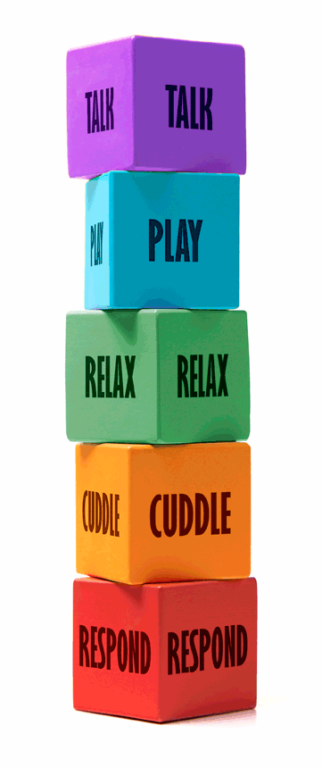
The “five to thrive” themes
Notes:
Slide 2 – What the blocks mean and how we relate them to using books and rhymes:
Respond – importance of responding to a baby and their moods. Using books and rhymes to stimulate or settle a child.
Babies respond to the black and white books by staring at them and waving their arms and legs and the parent can then respond to encourage that interaction.
The babies particularly respond to the faces, sometimes copying them, and we are able to talk about the baby’s brain’s inbuilt preference for faces
Cuddle – New born babies see short distances and the distance between being held in a parent’s arms to their face is perfect.
- Rhymes involve actions as well as the opportunity to tickle and bounce babies. When babies are hearing words and also being helped to do the actions or a parent does the actions on them e.g. round and Round the garden their brain is being stimulated and builds connection to a greater extent than with just listening.
Books are a great reason for parent and child to cuddle up together and focus on the same thing, enjoying the shared experience and helping to bond. Parent and baby can relax together with a book – I also mention that books can do the opposite and stimulate the baby – both relaxing and stimulating are good at the right time.
Books can be playthings too – as baby reaches out to grab what is interesting. Rhymes involve physical actions and are a fun way of spending play time with a baby
Parents can sometimes be unsure how to talk to a baby who doesn’t answer back, so a book is a useful tool to have something to talk about!
By talking to your baby they are being exposed to a large range of sounds and words to help them learn to speak. We talk about how it is best if your baby needs to be able to see your face and mouth movements when you talk and sing together.

Slide 4
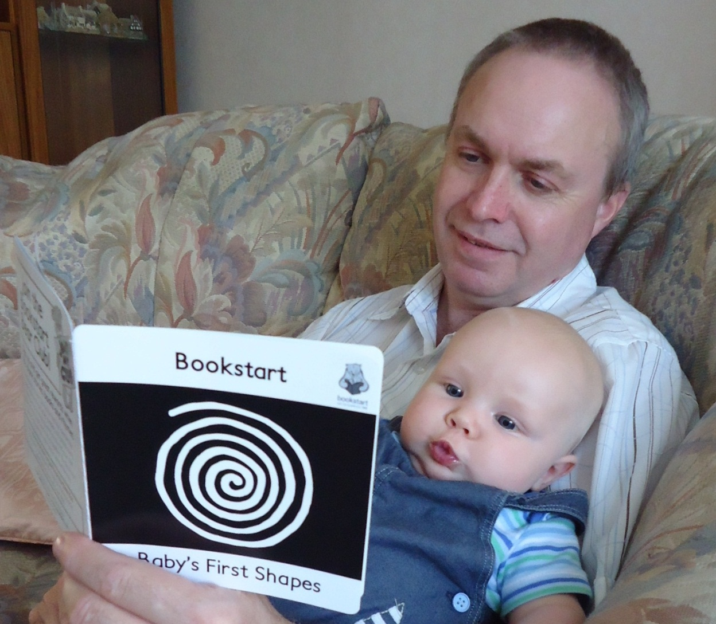
Why black and white book making?
Notes:
Why black and white book making
The black and white book making workshops were devised as a way that libraries could play a relevant role in the My Baby’s Brain programme.
Also supports the Bookstart programme and now plays a role in Children’s Library journeys
Although Health visitors give out the official Bookstart black and white book as part of the New Birth check for babies in Hertfordshire we thought it would be a good way to engage parents-to-be via pregnancy clubs and children’s centres.

Slide 5
Aims of the sessions
We want new parents and parents-to-be to understand the value of sharing books, songs and rhymes with their baby to support bonding, their baby’s brain development, family routines and language development.
To promote the benefits of library use and to encourage families to visit, and borrow from, the library.
Notes:
Read from the slide

Slide 6
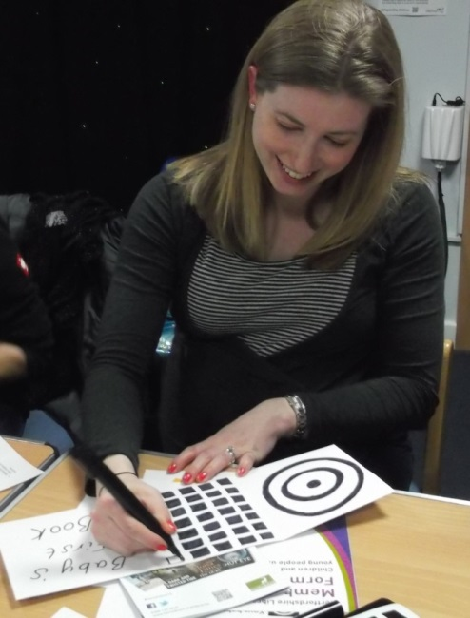
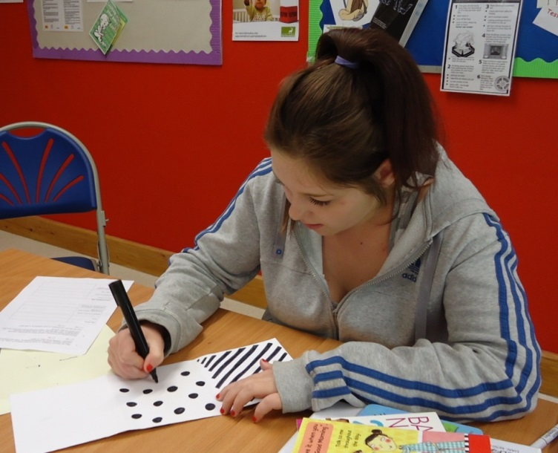
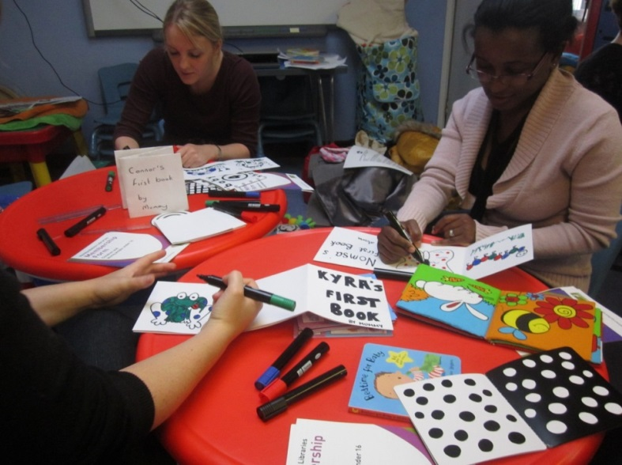
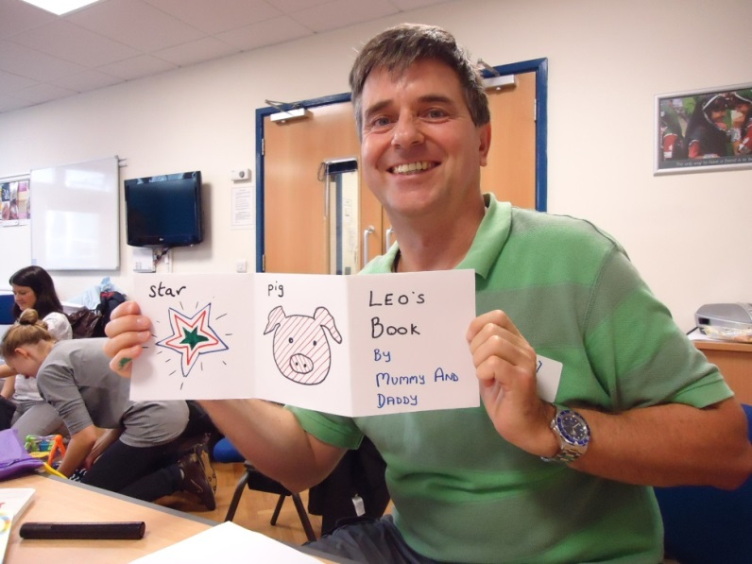
Our target audience
Notes:
who are our partners and audience
Pregnancy clubs
Plus one groups
Welcome to the world groups
Works best in an antenatal audience e.g. pregnancy group as it is more difficult for Mums to make the book as well as look after the baby. But in all groups the key messages are welcomed.

Slide 7
Resources – keep it simple
Black flip chart marker pens (and other colours if required)
Thick A3 paper that does not “bleed” and that can be folded into a concertina
Sample images and books
Boards to lean on
Rulers
Selection of board books to show
Tips sheet on sharing books with young babies
Rhymes to share with young babies
Bookstart Bear to demonstrate rhymes
Risk assessment
Notes:
Read slide

Slide 8
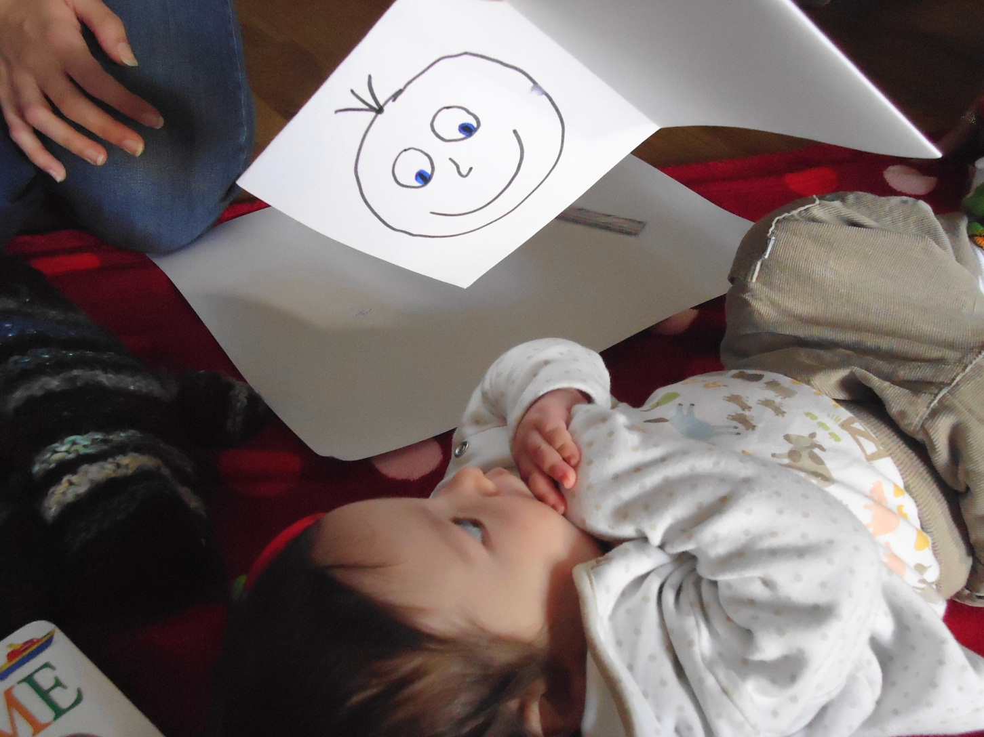
How we run the sessions
Notes:
running black and white book making workshops at new baby groups or pregnancy groups:
Talk about the fact that new-borns only see in black and white and that they are fascinated by the contrast between black and white and also fascinated by faces
Talk about the ‘Five to Thrive’ blocks and illustrate them with books that can be borrowed from the library.
I show the parents some black and white books and they then make a black and white zig zag book for their baby by drawing patterns and faces with black felt pens. For babies older than 3 months basic shapes using colours are introduced colours. Some participants may be unsure at first but soon see how basic the books need to be and find it the action of drawing and creating quite therapeutic.
If the baby is at the session then parents show their black and white books to their babies straight away and are very interested in the way the babies focus on the images and move their bodies to show their excitement.
Mention about dual language homes and benefit of speaking both languages in the home.

Slide 9
Promote the library
“I didn’t know anything about books for babies so I found it really helpful and will look forward to sharing books with my baby.
It was also great to get information about the library as it wasn’t something I had thought about.”
Notes:
Promote library membership, show book examples and promote our Baby Rhyme Times

Slide 10
Share a rhyme at nappy time
Cheek, chin
Cheek, chin, cheek, chin, cheek, chin,
NOSE
Cheek, chin, cheek, chin, cheek, chin,
TOES
Cheek, chin, cheek, chin, cheek, chin,
UP baby goes!
(and slide the nappy under baby’s bottom)
(Reproduced with kind permission from “Hipperty-hop,Hipperty-hay”, Opal Dunn, published by Francis Lincoln)
These are Baby’s Fingers
These are baby’s fingers, these are baby’s toes
This is baby’s tummy button
Round and round it goes
These are baby’s ears, this is baby’s nose
This is baby’s tummy button
Round and round it goes
(Reproduced with kind permission from “Hipperty-hop,Hipperty-hay”, Opal Dunn, published by Francis Lincoln)
Notes:
We talk about sharing rhymes with babies – at nappy times and any time.
We sing some rhymes together from a sheet provided that has rhymes aimed at very young babies.

Slide 11
Feedback from a Mum-to-be
I'd definitely encourage sessions again regarding the importance of reading to your babies both from birth and in the tummy and felt that making your own book was a nice light hearted way of imagining what your own baby would be interested in looking at.
Plus it was something nice to show my partner as a way of explaining what we'd covered that session!
Notes:
– feedback and monitoring
We monitor the number of sessions held and gather comments from attendees but we do not have any County or individual library targets.
We also do not formally track if people attending the sessions then come and use the library. We do know that where a member of staff attends each cohort of “Welcome to the world groups” – this has a positive impact on increasing attendance at BRT in that library,

Slide 12
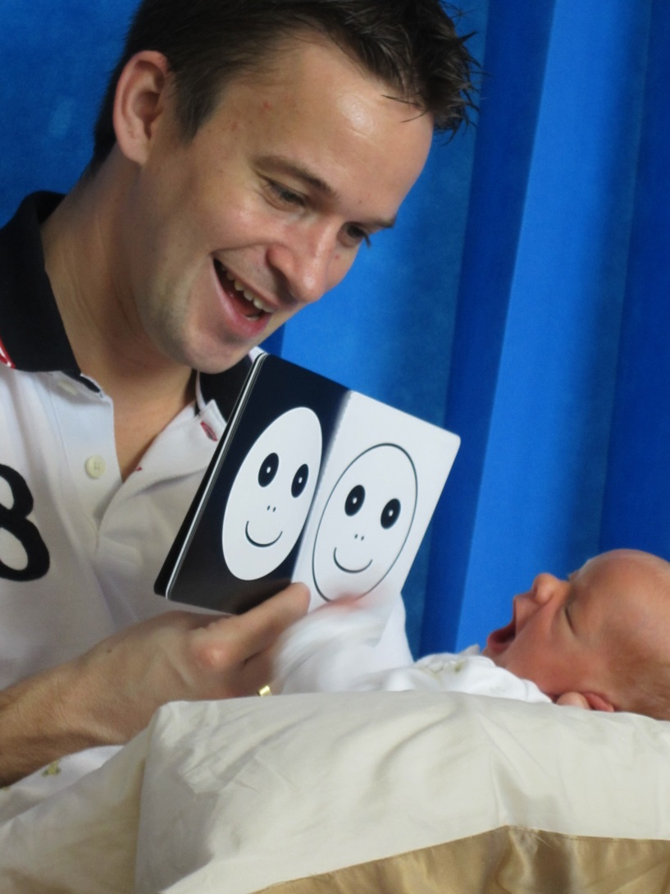
From pregnancy club to birth day – one very proud Dad!
Notes:
Tell the story of Luca

Slide 13
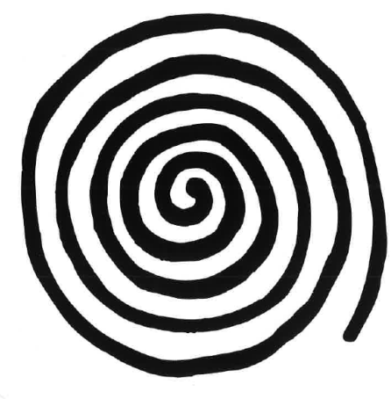
Black and white bookworm
Notes:
The black and white Bookworm
One of our health visitors has been working with a family where the parents are both teenagers. In an attempt to engage the young father before his baby was born, she gave him the Bookstart “baby’s first shapes” book and explained to him how he could share it with his new son right from the start. She talked about how babies like to look at the black and white shapes and the faces in the book and how doing so helps their brain develop. His attitude at the time was “what a load of rubbish” and she went away fully expecting the book to go straight in the bin.
However next time they met, after the baby had been born, the father greeted her with great excitement. He had kept the book and was now sharing it with his new son. He told me how his son liked the black spiral best and would stare at it for ages in wonder. She then watched as Dad weaved his finger round the spiral, gently telling his baby it was a round, round worm. It was so lovely to see the affection between father and son, smiling and responding together.
Health Visitor, Hertfordshire

Slide 14
Key websites
www.fivetothrive.org.uk
www.hertsdirect.org/services/edlearn/css/mbb/
www.socialbaby.com

Slide 15
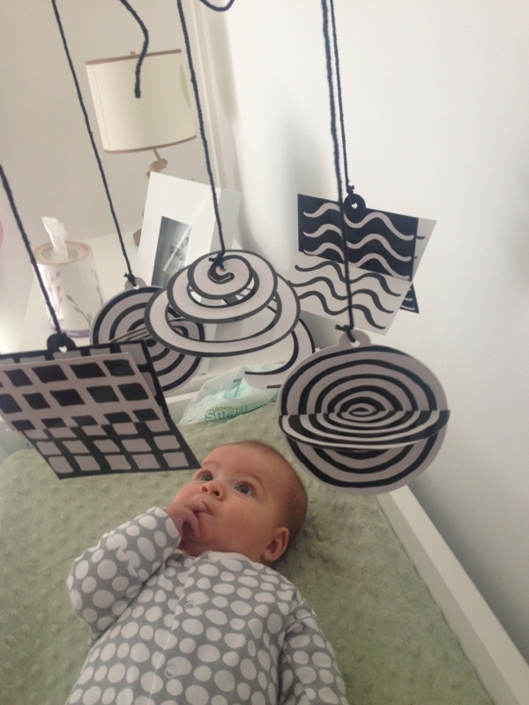
Any questions?

Slide 16
My baby’s brain – five to thrive
http://www.hertsdirect.org/services/edlearn/css/mbb/
https://www.youtube.com/watch?v=CsiUayJOJ8Q&feature=playembedded

