Slide 1
Baby Shower Case study
Annabel Gittins
Library Manager for CYP
Shropshire Libraries

Slide 2
Why a Baby Shower – in a library?
Ties into a current trend
Offering fun, informative event for expectant and new parents (up to 1 year)
Introduces new partners into library space
Introduces new library users
Highlights library as heart of community
Created or enhanced links with health, business, charities
Showcasing library resources
Health Zones Parents collections
Rhyme & Story Times Early Reading schemes & dual language
Activity books Work clubs
Computer help CV writing
Digital Offer – emagazines, ebooks etc.
Local information – clubs, groups, activities for parents…

Slide 3
Contribution to Local Authority agenda
Partnership working
Health and Libraries working closely
Showing library as a community Hub
Shropshire Health & Wellbeing strategy – Start well, Live well, Age Well
Healthy weight and diabetes care
Carers
Mental health
Ties into SCL Universal offers

Slide 4
Who did we invite? Advice and Information Services
Health Visitors | Leisure Centres
Midwives | Local Diabetes Support Group
St John’s Ambulance | Bookstart
Surestart / Children Centres | Baby Sensory
Help2Change | Baby Yoga
Health Watch | Maternity Engagement Group
N.C.T. | Water Babies
Real Nappies | Family Nurse Practice

Slide 5
Who did we invite? Local Businesses
Boots | Photographers
Halfords – car seats | Diddi Dance / Pyjama drama
Local baby stores | Water babies
Toy shops | Osteopath – Paediatric / Women’s health
Card / balloon shops | Local Nurseries
Christening gift shop | Breastfeeding friendly Cafés
Soft play areas | Sewing / Craft workshops

Slide 6
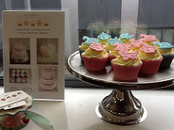
Activities in Library
Refreshments – WI or cupcakes...
Rhyme Times – 10 mins x 2
Poetry-on-Demand
Play dough
Games with small prizes eg. Local bookshop token, local soft play area
Guess the celebrity baby
Guess the no. of cotton wool balls in jar
Baby name competition
Goody Bag – library information, Bookstart & information from those who could not attend.

Slide 7
Promotion and Evaluation
Promotion
Posters and leaflets everywhere
Social media – start the conversation early
Press releases and coverage on the day
Visit Bumps to babes groups
Evaluation
We did not let anyone leave without filling out an evaluation form – 2 of us on exit.
Prize Draw for completed forms (family ticket to Severn Valley Railway or Local Bowling/Activity centre)
Evaluation Form for stall holders

Slide 8
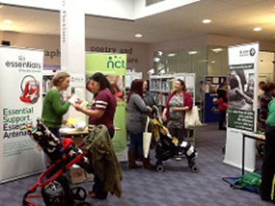
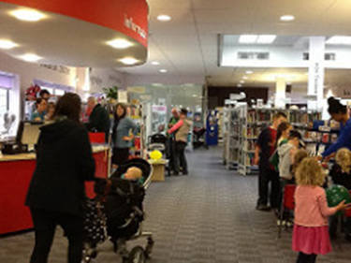
Evaluation
47 family groups attended
45 evaluation forms collected
24 families = not previous library users
14 new members joined
28 intend to join babies when born
Footfall
Average for a Saturday = 500
Baby Shower Saturday = 839!

Slide 9
Evaluation cont.
How did you hear about this event?
Poster | 11
Leaflet | 6
Website | 2
Facebook | 10
Twitter | 0
Word of mouth | 9
Local news | 7

Slide 10
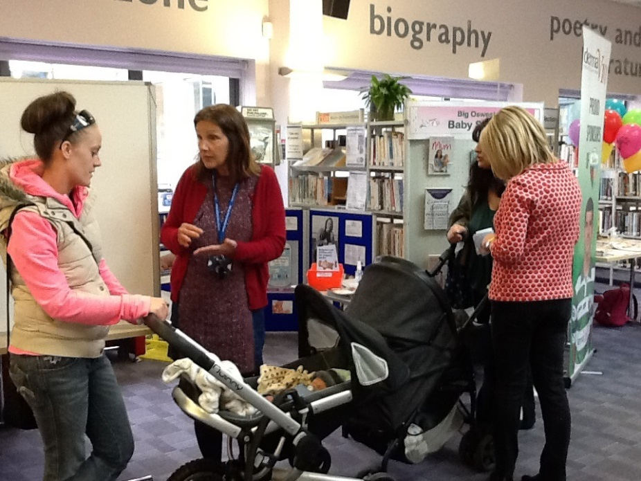
“The Best Bits….”
Chatting to Health Visitors
All sorts of information on what’s available in one place
St John’s Ambulance and seeing what’s on locally
All of it!
Local information
Real Nappies, Health Visitors
Rhyme Time
Meeting other mums and babies

Slide 11
Accomplishments & Lessons Learnt
Really good working relationships with local health teams
Baby Shower idea appeals to Health and Engagement panels – raising profile of the library at a more strategic level
Rhyme Time numbers are soaring!
Start planning early
Contact people many times – you will eventually get an answer!
Get an early conversation going in social media – promote so that people are tripping over “baby shower” everywhere.
Where staff are not “local” much more work needed to bring in stalls / promotion etc.
Need good staff / customer ratio on the day – use volunteers when possible!
Refreshments and plenty of places for pregnant ladies to sit down!

Slide 12
